Slide 1
Interim Project
Team 2
Member 1
Member 3
Member 2
Member 4

Slide 2
Question
Q1
What are the regional sales in the best performing country?
Q6
What is the relationship between the size of the stores, number of employees and revenue?

Slide 3
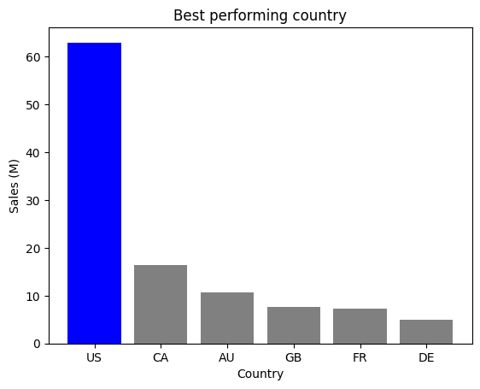
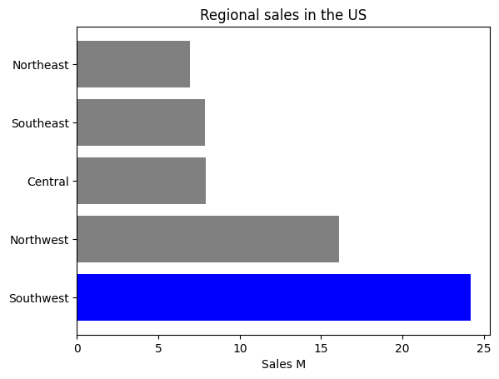
Within the US, the Southwest had just under 25 million, making it the best performing region in the US.
Q1
What are the regional sales in the best performing country?
Looking at the data, we found that the US is the best performing country. With over 60 million dollars in sales, more than tripling the rest of the countries.

Slide 4
Question
Q1
What are the regional sales in the best performing country?
Q2
What is the relationship between annual leave taken and bonus?

Slide 5
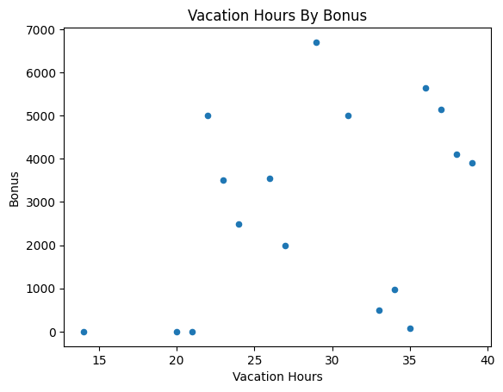
From the scatter plot we deduced that vacation hours and bonus have a weak positive correlation, meaning that the higher bonus that Is received the more vacation hours an employee is likely to spend.
Q2
What is the relationship between annual leave taken and bonus?

Slide 6
Question
Q1
What are the regional sales in the best performing country?
Q2
What is the relationship between annual leave taken and bonus?
Q3
What is the relationship between Country and Revenue?

Slide 7
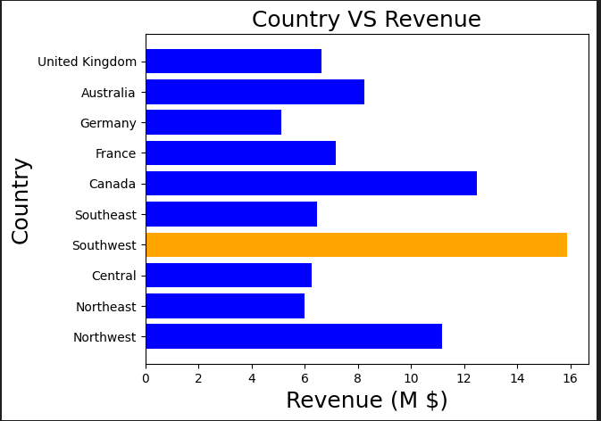
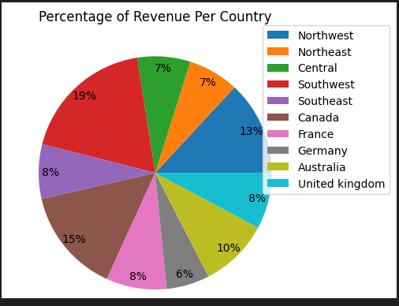
US
Q3
What is the relationship between Country and Revenue?
From the bar chart, the Southwest in the US has the highest revenue while Germany has the lowest.
The pie chart presents the percentage of revenue for each country, except the US which is split into regions. With the Southwest in the US having the highest percentage of 19% and Germany with the lowest percentage of 6%.
US

Slide 8
Question
Q1
What are the regional sales in the best performing country?
Q2
What is the relationship between annual leave taken and bonus?
Q3
What is the relationship between Country and Revenue?
Q4
What is the relationship between sick leave and Job Title?

Slide 9
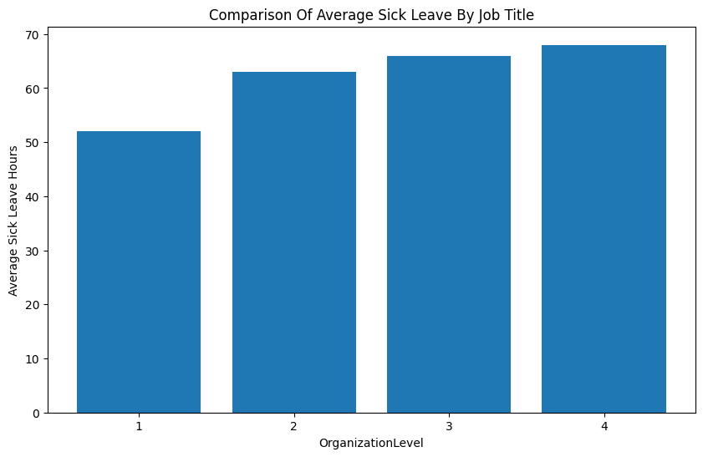
The bar chart shows that the lower(Level 4) the organization level the higher the average sick leave. Indicating that as people move into a higher position they take less sick leave.
Q4
What is the relationship between sick leave and Job Title?

Slide 10
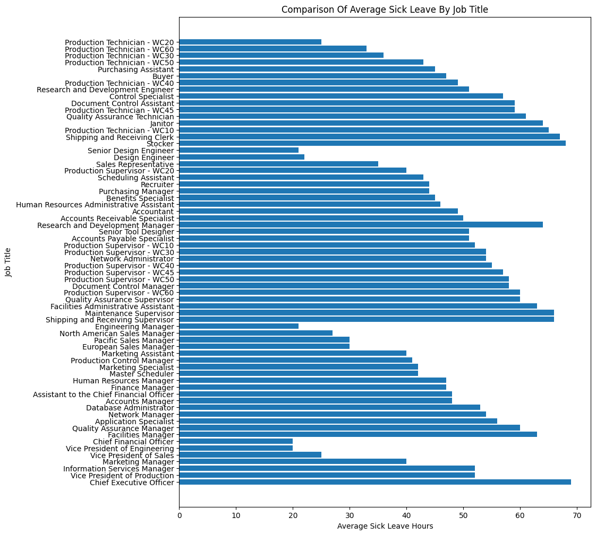
This chart shows the job title for the average sick leave hours. And we can see the breakdown of each job and the average sick leave which each person with that job has taken.
The chief executive officer has taken the most sick leave but isn’t associated with a conventional organization level.
The chief financial officer and vice president of engineering have the lowest sick leave hours.

Slide 11
Question
Q1
What are the regional sales in the best performing country?
Q2
What is the relationship between annual leave taken and bonus?
Q3
What is the relationship between Country and Revenue?
Q4
What is the relationship between sick leave and Job Title?
Q5
What is the relationship between store trading duration and revenue?

Slide 12
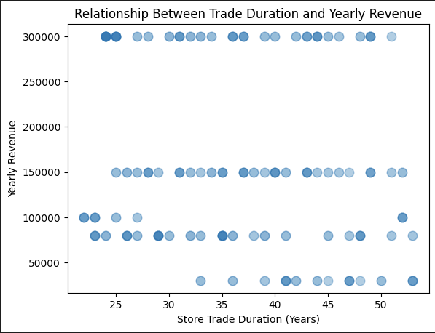
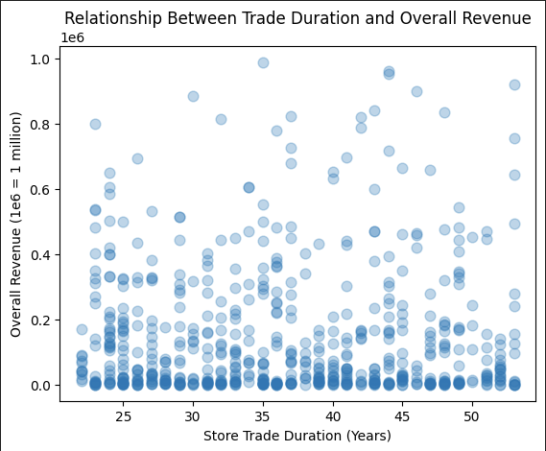
While analysing the data, we found there is no correlation between yearly revenue and trade duration, as can be seen from this scatterplot. Across 625 recorded stores, most stores fall evenly within one of three ranges; these being 80k, 150k, or 300k. The data also contained a few outliers.
There is no correlation between trade duration and revenue, as can been seen from this scatterplot. Across 625 recorded stores, most stores fall within the 0 - 200k revenue bracket (this data represents the total revenue for the entire trading duration, not annual revenue). Less stores fall within 200k - 400k bracket, and all stores over 400k are outliers in accordance with this data.
Q5
What is the relationship between store trading duration and revenue?

Slide 13
Question
Q1
What are the regional sales in the best performing country?
Q2
What is the relationship between annual leave taken and bonus?
Q3
What is the relationship between Country and Revenue?
Q4
What is the relationship between sick leave and Job Title?
Q5
What is the relationship between store trading duration and revenue?
Q6
What is the relationship between the size of the stores, number of employees and revenue?

Slide 14
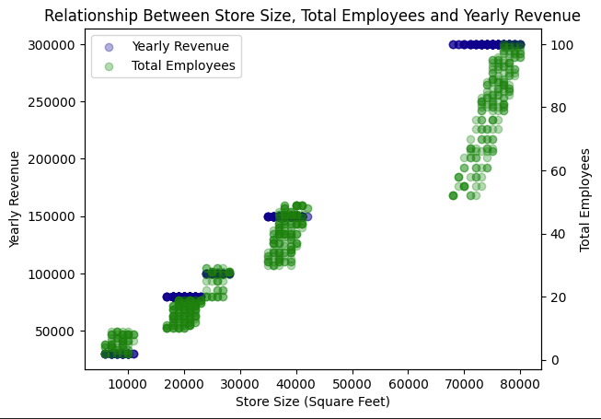
While analysing the data we found a positive correlation between store size, yearly revenue and total employees. We can clearly see that as stores increase in size, there is a trend in hiring more employees and increasing their revenue. In the next slide, particular graphs will be displayed in relation to this data comparison.
Q6
What is the relationship between the size of the stores, number of employees and revenue?

Slide 15
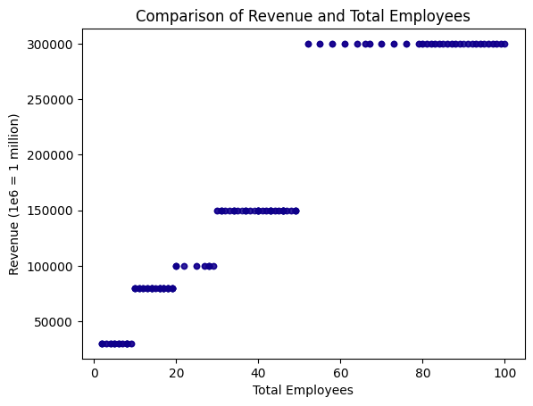
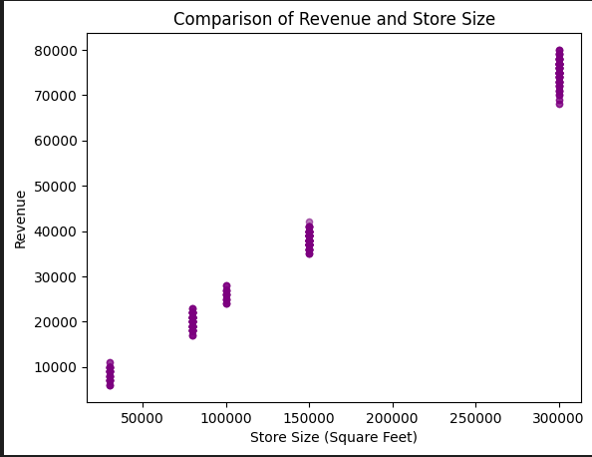
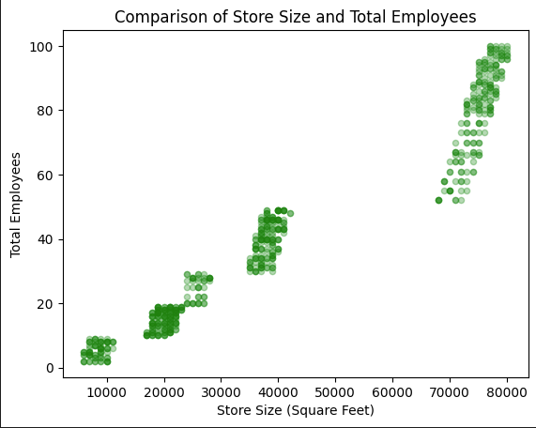

Slide 16
Thanks for watching!

